Slide 1
RESUME MATCHING ONTOLOGY
BY
RAMYA DURAISAMY
SID : 2241387

Slide 2
ONTOLOGY
Set of concepts within domain and relationship between them.
Enable the users to connect multiple concepts to other concepts
Classes - represent the entities
Properties - attributes of the class
Individuals - exact value
Axioms - rules

Slide 3
ABOUT THE ONTOLOGY
Matching the Job description with the resumes
Used for Online screening process
About the architecture of the system
Included different fields in ontology

Slide 4
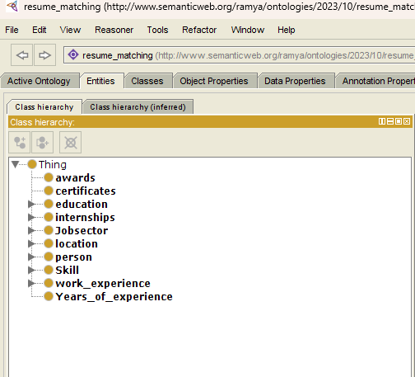
These are the classes.
Based on the job profiles,
Key words will be extracted

Slide 5
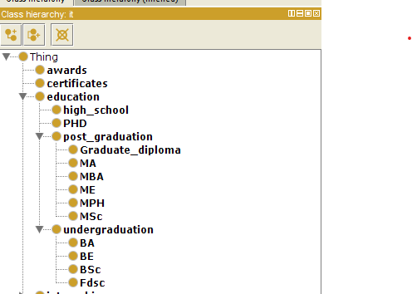
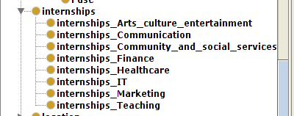

Slide 6
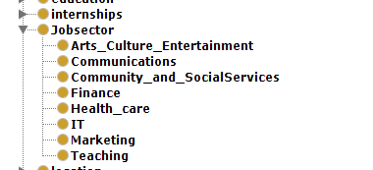
These are the job fields.

Slide 7

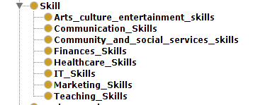
Based on skill, work experience, education the candidates will be selected

Slide 8
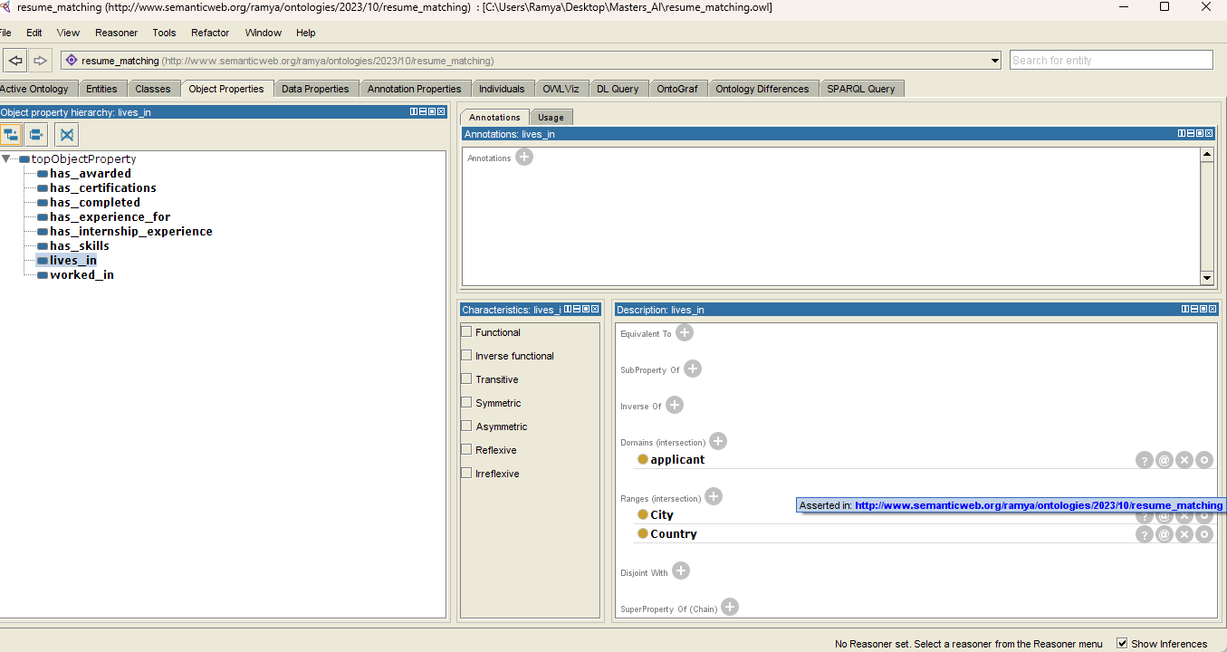

Slide 9
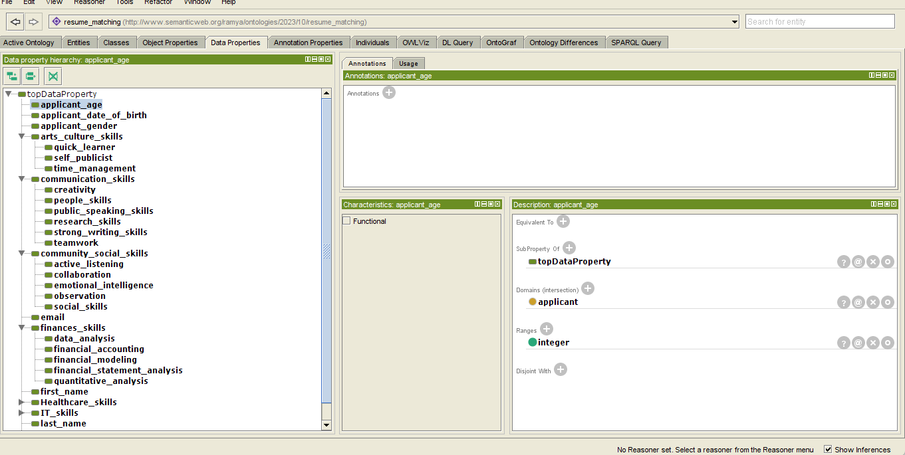

Slide 10
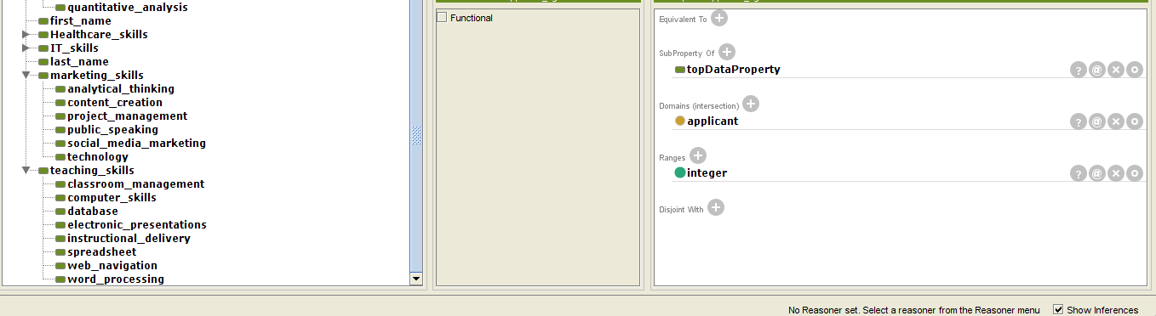
Skills as the data properties. Compare the required skills with candidate’s skills

Slide 11
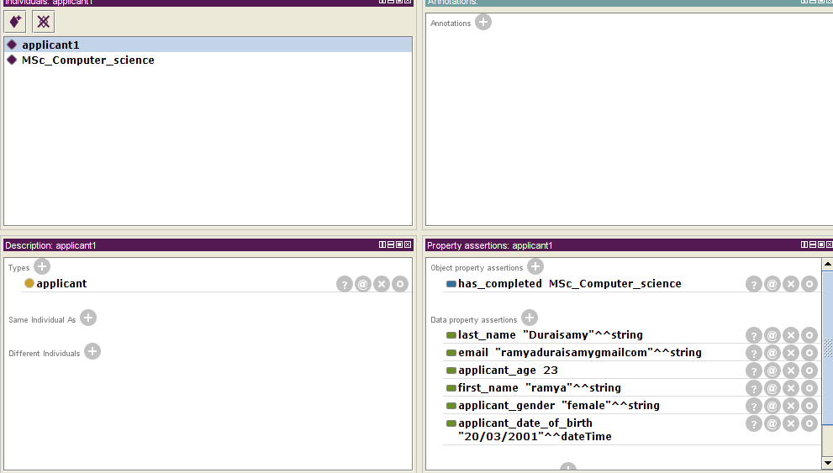

Slide 12
REFERENCE
https://www.ontotext.com/knowledgehub/fundamentals/what-are-ontologies/
Faliagka, E., Iliadis, L., Karydis, I., Rigou, M., Sioutas, S., Tsakalidis, A. and Tzimas, G. (2013). On-line consistent ranking on e-recruitment: seeking the truth behind a well-formed CV. Artificial Intelligence Review, 42(3), pp.515–528. doi:https://doi.org/10.1007/s10462-013-9414-y.
ieeexplore.ieee.org. (n.d.). An Ontology-Based Approach for the Semantic Representation of Job Knowledge | IEEE Journals & Magazine | IEEE Xplore. [online] Available at: https://ieeexplore.ieee.org/abstract/document/7140782?casa_token=_A6oHELbSIMAAAAA:tzK_YF4d9sybi2noJKWEqM979CWHUHtsdo-SKPRRhowMCb1xbNGDdjiHBVkwWXFY8hpdouqG [Accessed 20 Nov. 2023].
ieeexplore.ieee.org. (n.d.). An Ontology-Based Approach for the Semantic Representation of Job Knowledge | IEEE Journals & Magazine | IEEE Xplore. [online] Available at: https://ieeexplore.ieee.org/abstract/document/7140782?casa_token=_A6oHELbSIMAAAAA:tzK_YF4d9sybi2noJKWEqM979CWHUHtsdo-SKPRRhowMCb1xbNGDdjiHBVkwWXFY8hpdouqG [Accessed 20 Nov. 2023].

Slide 13
THANK YOU

